Slide 1
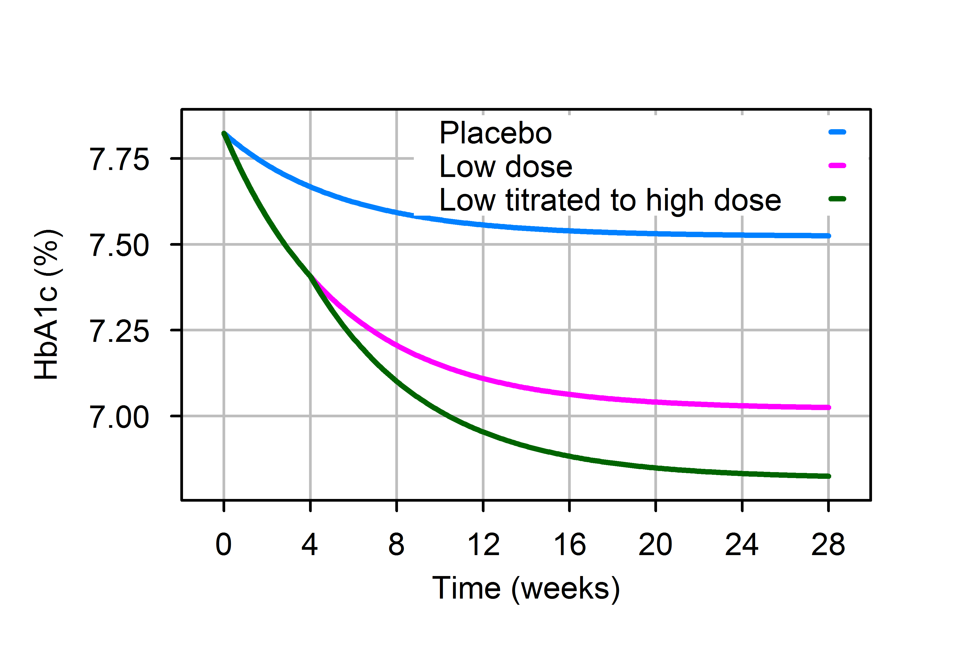
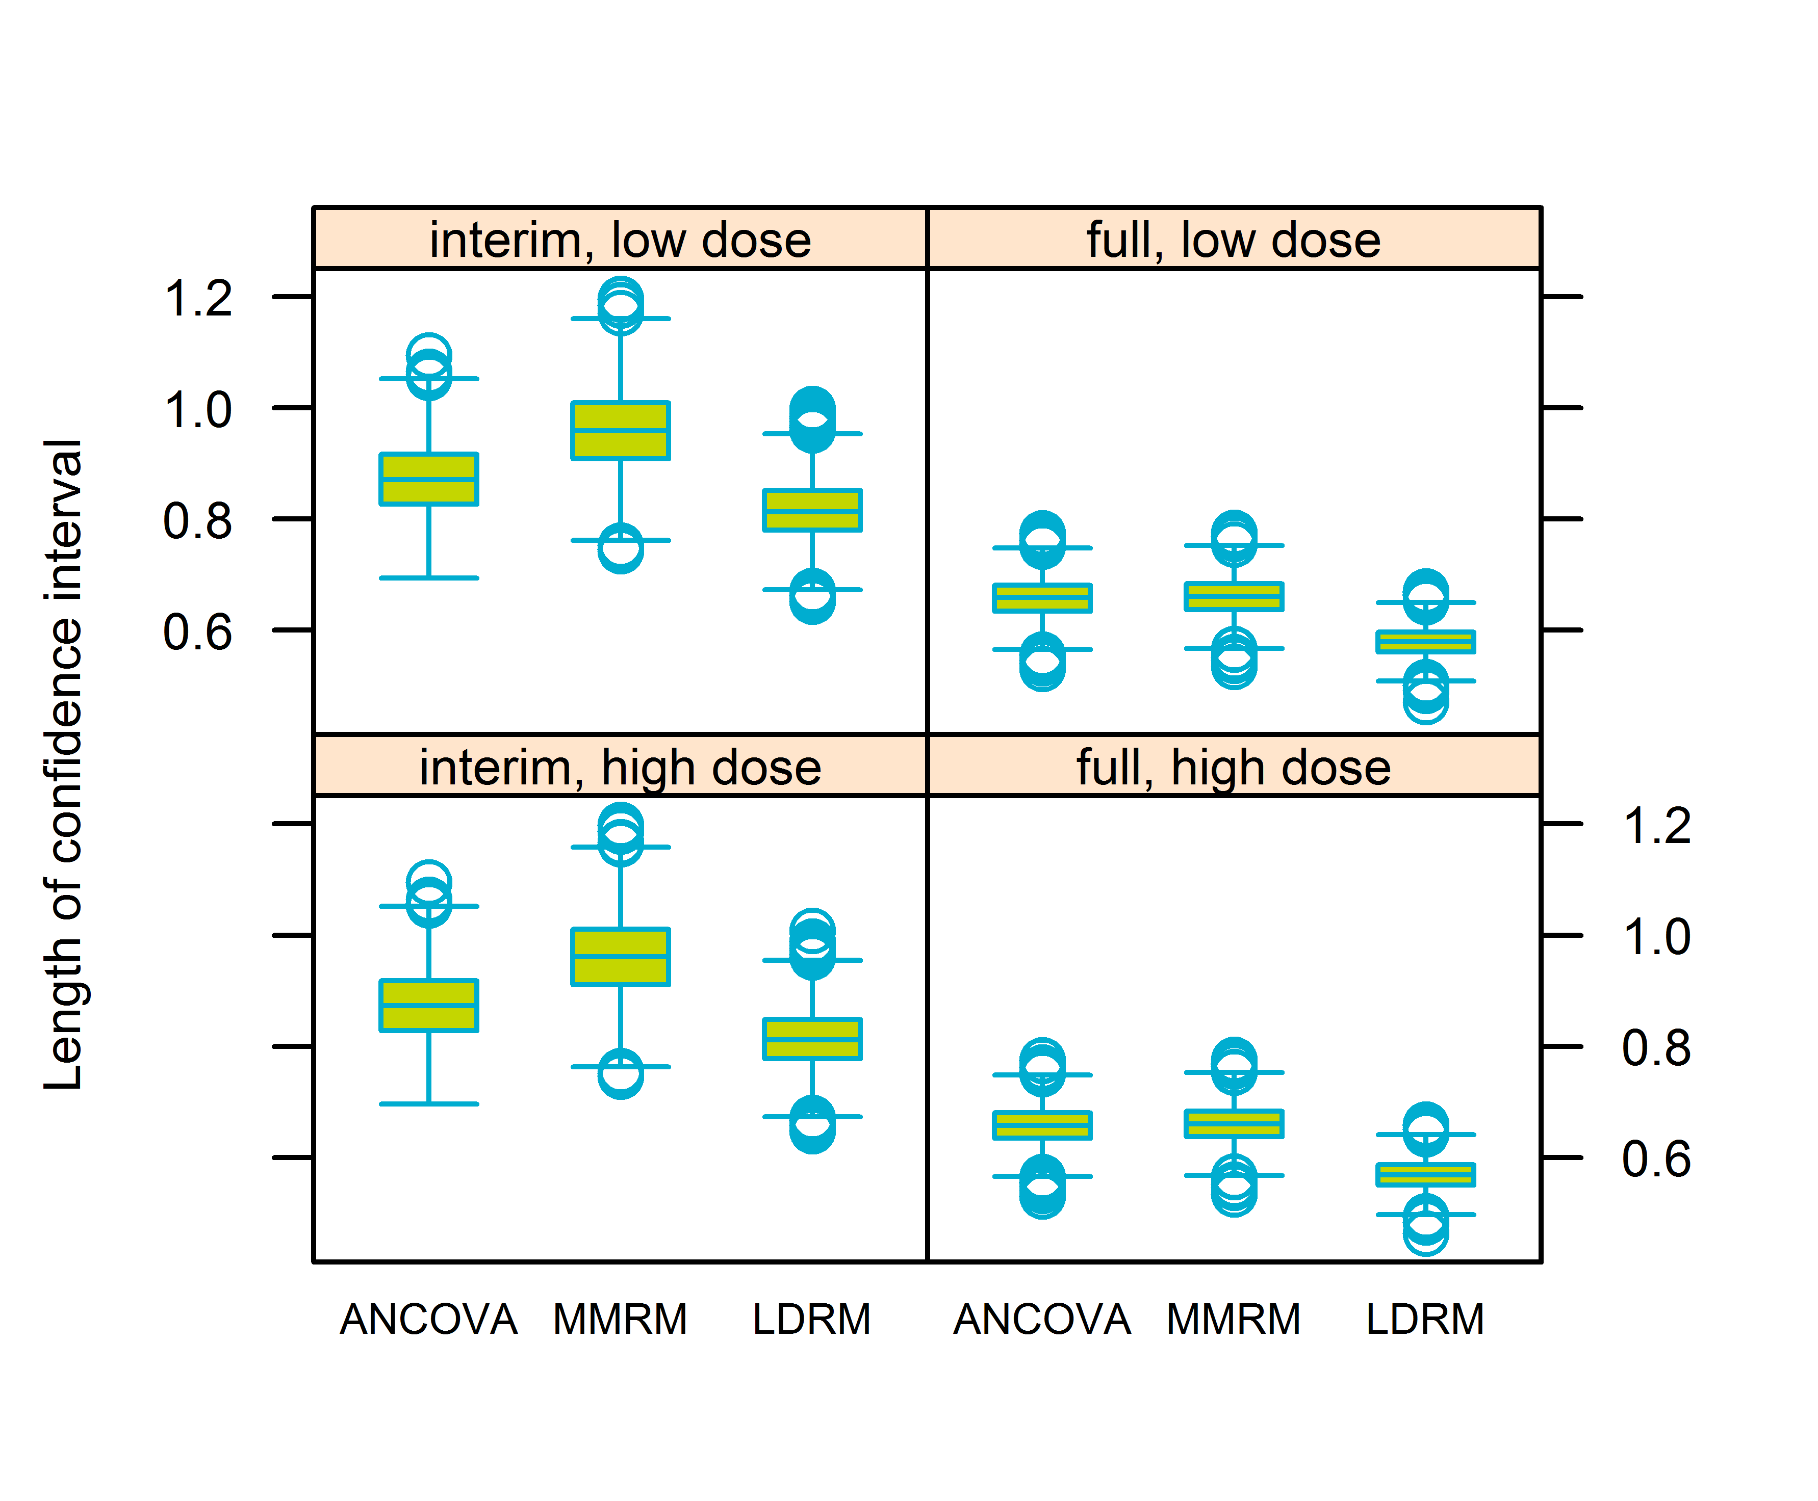
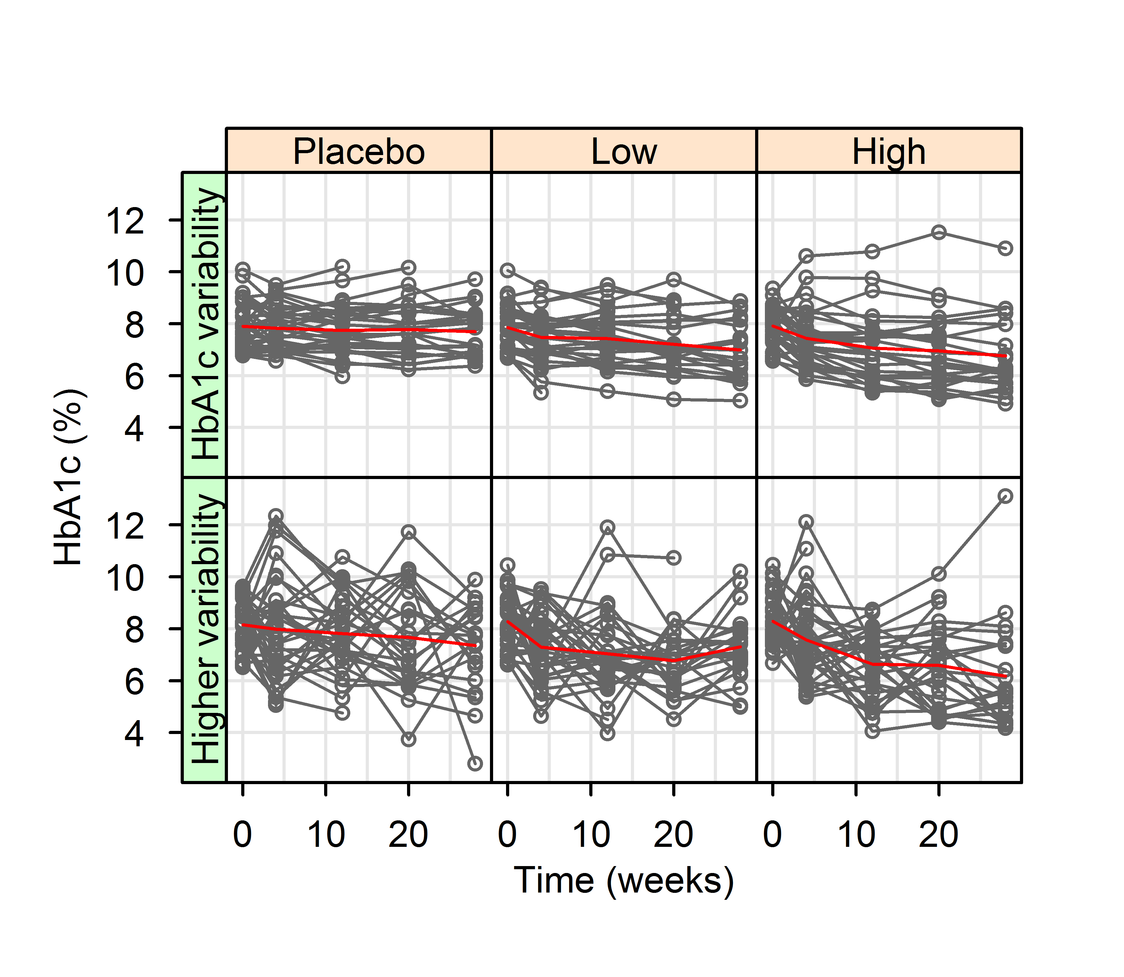
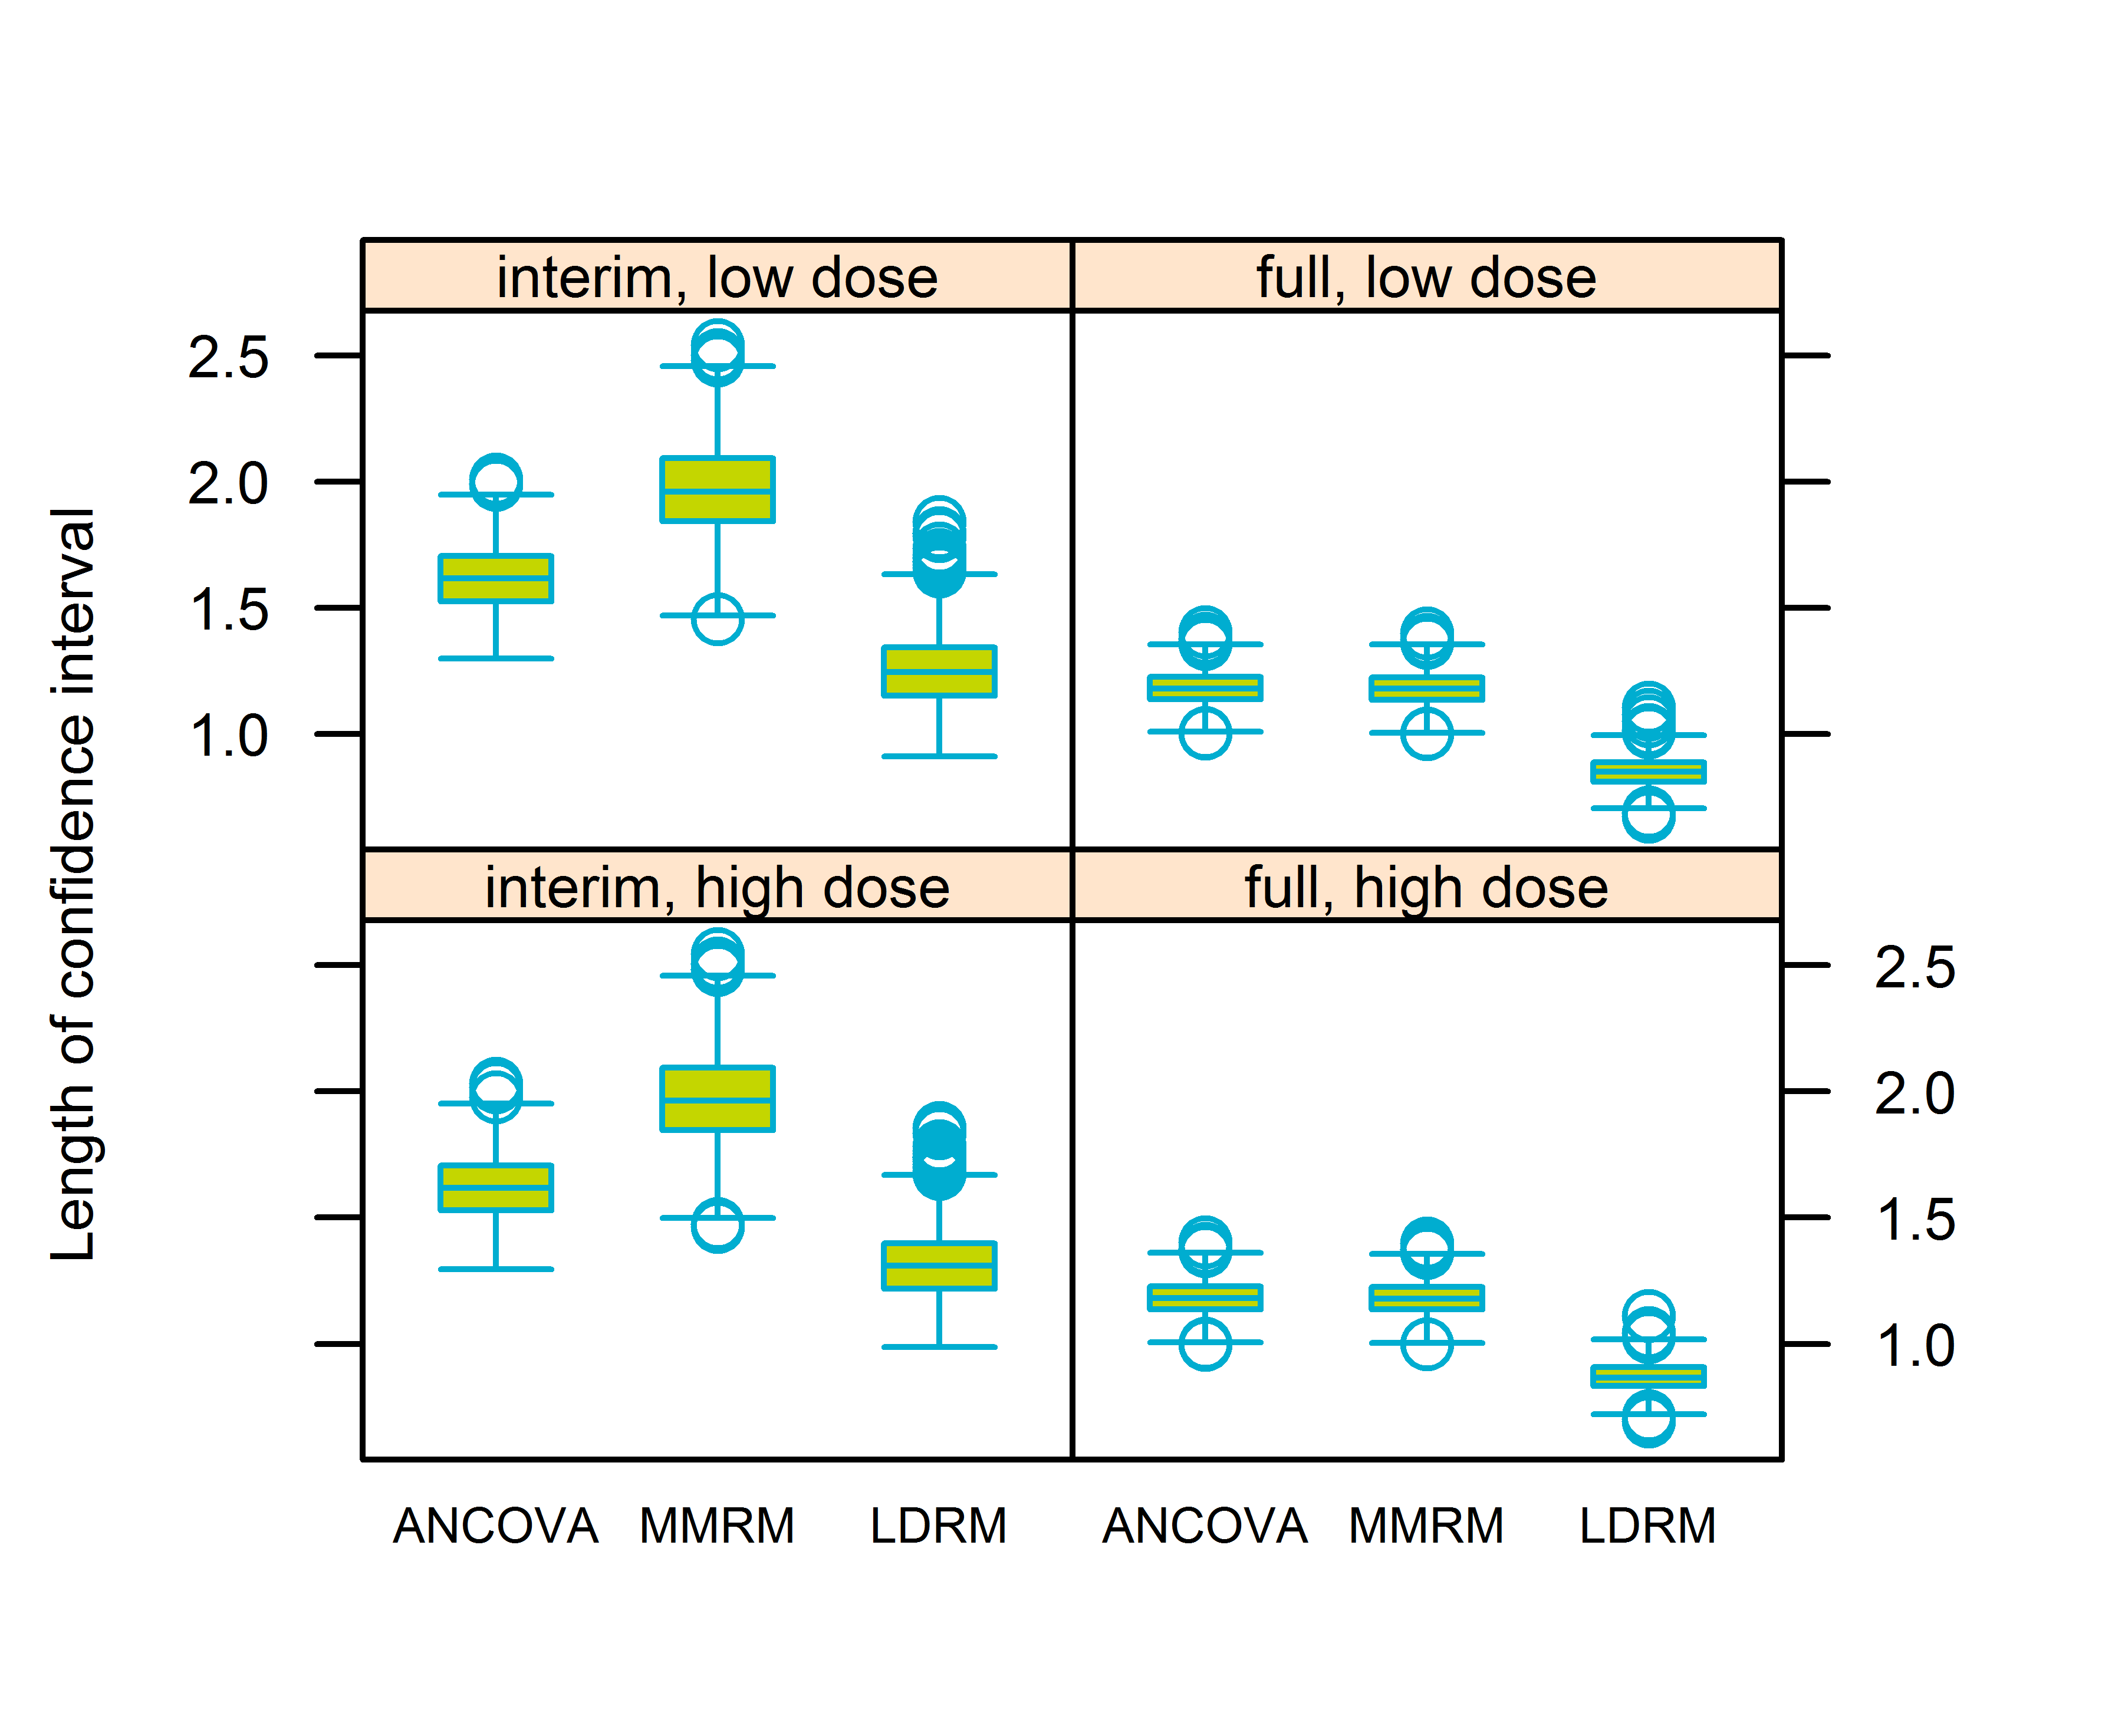
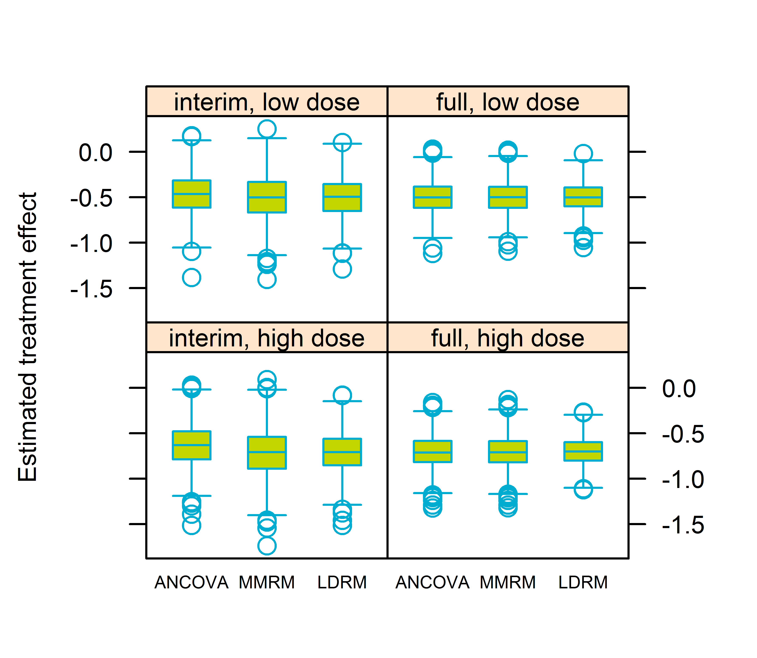

Longitudinal dose-response modelling as primary analysis of a clinical study
Karin Nelander, Bengt Hamrén, Susanne Johansson, Magnus Åstrand
Quantitative Clinical Pharmacology, Innovative Medicines and Early Development Biotech Unit, AstraZeneca, Gothenburg, Sweden
Introduction
Simulation setup
Model parameters for simulations were tuned using repeated measurement data from multiple in-house completed studies and baseline data from the motivating study to match the treatment effect and STD assumed in sample size calculation of the motivating study.
Table 1 Simulation results using original parameters:
The first row for each method represents analysis result after all patients have completed the study, and the second row represents analysis results at interim.
ANOVA or analysis of covariance (ANCOVA) commonly used as primary analysis for clinical studies
For studies with repeated measurements Mixed-Effect Model Repeated Measure (MMRM) often used as either primary or secondary analysis
Drawback for both methods:
  No predictions for doses not tested in study
  No or low information gained from data at intermediate study visits
Objective:
To evaluate longitudinal dose-response modelling (here LDRM) of all measured data with aim of estimating treatment effect at end of study, both in terms of power and type 1 error for
A typical HbA1c study
A study with an end-point having higher within patient variability
 | Low dose |  |  | High dose
 | Power (%) | Type 1 err. (%) | Length CI (%) | Power (%) | Type 1 err. (%) | Length CI (%)
ANCOVA | 84 | 5.1 | 0.7 | 98 | 4.8 | 0.7
 | 56 | 5.2 | 0.9 | 81 | 4.9 | 0.9
MMRM | 84 | 5.1 | 0.7 | 98 | 4.8 | 0.7
 | 54 | 5.4 | 1.0 | 81 | 5.0 | 1.0
LDRM | 91 | 5.0 | 0.6 | 100 | 5.4 | 0.6
 | 68 | 5.2 | 0.8 | 92 | 5.6 | 0.8
Figure 2 Hypothetical HbA1c over time during treatment
Figure 5 Box plot of length of confidence interval for treatment effect in the case of HbA1c variability (A) and higher within variability (B). Whiskers and dots as for figure 4
Repeated measured data was simulated according to study protocol with HbA1c at baseline (week 0) and weeks 4, 12, 20, 28. Data for interim included 105 patients, 66 with full data and 39 with partial data (baseline and 1-3 on treatment visits). Final analysis included 195 patients all with full data.
A
Methods
Clinical trial simulations were performed of a placebo controlled multi dose study with end of study HbA1c treatment effect as primary endpoint and for a similar study with an endpoint with higher within patients variability
Simulations were performed in R (version 3.2.2, the R Foundation for Statistical Computing)
Analyses were performed in SAS (version 9.3, SAS Institute Inc., Cary, NC, USA)
  For ANCOVA and MMRM proc MIXED was used
  For LDRM proc NLMIXED was used, with CI computed using the delta method (NLMIXED default)
Last value carried forward was used for ANCOVA at interim, and in all ANCOVA analyses baseline measurements of the endpoint was used as covariate
Unstructured correlation was used for MMRM
1000 simulated studies were used to evaluate power (portion of CI excluding 0) and precision (average length of CI)
10,000 simulated studies with treatment parameters set to 0 were used to evaluate type 1 error (proportion of CI excluding 0)
Figure 3 Typical simulated studies at interim, red line is average per time point
B
Results
The simulations show that the LDRM performs as good as or better than ANCOVA and MMRM (see tables 1 and 2, figures 4 and 5). LDRM provided somewhat better power for the full analysis of the typical HbA1c study. For the interim and the case of higher within patient variability the improvement was higher. The type 1 error was overall similar for the methods and all cases studied.
Table 2 Simulation results using inflated within individual error:
The first row for each method represents analysis result after all patients have completed the study, and the second row represents analysis results at interim.
 | Low dose |  |  | High dose
 | Power (%) | Type 1 err. (%) | Length CI (%) | Power (%) | Type 1 err. (%) | Length CI (%)
ANCOVA | 37 | 5.0 | 1.2 | 64 | 5.2 | 1.2
 | 19 | 4.9 | 1.6 | 31 | 4.6 | 1.6
MMRM | 37 | 5.1 | 1.2 | 64 | 5.2 | 1.2
 | 18 | 5.2 | 2.0 | 29 | 4.9 | 2.0
LDRM | 54 | 5.3 | 0.9 | 88 | 5.4 | 0.9
 | 29 | 5.3 | 1.3 | 53 | 5.4 | 1.3
Background on study motivating evaluation
A 28 weeks HbA1c study designed to compare two doses to placebo was ongoing, however, with slow recruitment. The aim was to recruit 195 patients and with 105 recruited patients the study team wanted to explore the option of prematurely terminating the study: Would there be enough power to detect a treatment effect? Could alternative analysis methods increase power?
Figure 4 Box plot of estimated treatment effect in the case of HbA1c variability (the same patterns is seen with higher variability). Whiskers go out to the most extreme point within 1.5 times the inter quartile range. Observations outside of that range are indicated with a dot
Drug effect as inhibitory on the input rate of HbA1c
Conclusions
k_{in}
k_{out}
Longitudinal dose-response modelling can contribute more informed decision making than using ANCOVA or MMRM, providing increased power and precision and sufficient control of type 1 error. In this setting ANCOVA appears to perform better than MMRM.
The level of increased power and precision for LDRM is higher for endpoints with higher within individual variability.
HbA1c
Simulate indirect response model for HbA1c
Formation of HbA1c represented by a 0-order process governed by k_{in}
Elimination represented by a 1-order process controlled by k_{out}
Drug effect as inhibitory effect on k_{in}
Supported by
Presented at The PAGE 2016 meeting, Lisbon Portugal, 7-10th of June 2016

